Slide 1
BLOCKCHAIN
Proof of Stake
Pr. TMIMI Mehdi

Slide 2
Main goal
Discuss :
The proof of stake mechanism
Risks involved and benefits

Slide 3

Proof of work concept
Each Miner groups verified transactions into a block.
Start solving a mathematical puzzle.
The reward and the transactions fees are given to the first miner who solves the puzzle.
The mined block is broadcasted.
Other miner can verify it and add it to their blockchain

Slide 4
Proof of work problems
As the network grows => computing power and electricity usage
Higher reward are given to people with better and more equipment
Mining pools makes the blockchain more centralized than decentralized
=> We need a new consensus algorithm

Slide 5
Proof of Stake concept
In 2011 a Forum user called 'QuantumMechanic' proposed a technique that he called "Proof of Stake"
The basic idea is to let everyone compete against each other with mining is just wasteful
=> he proposed an election process in which 1 node is randomly chosen to mine validate the next block.

Slide 6
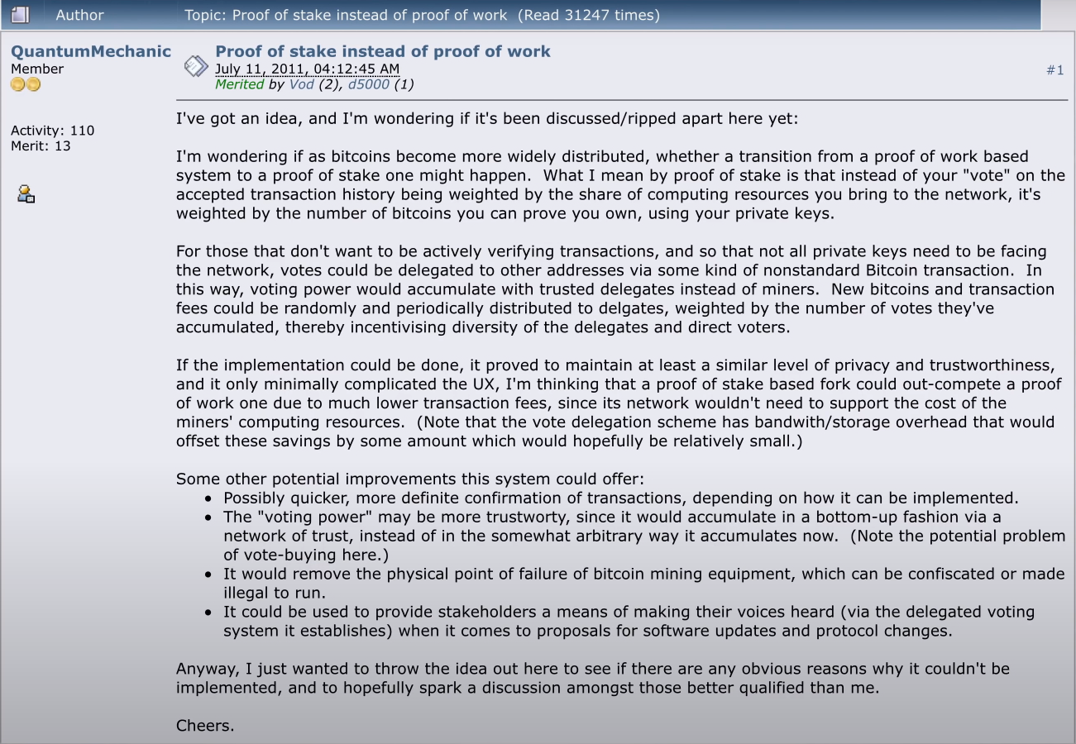
Proof of Stake Proposal

Slide 7


Proof of Stake Terminologies
a
Miners
Validators
Mining
Minting / Forging
Notes:
https://bitcoinblockhalf.com/

Slide 8
Validators
Validators are not chosen completely randomly
To become a validator, a node has to deposit a certain amount of coins into the network as Stake => Security deposit
The amount of the stake determines the chances of a validator to be chosen to forge the next block.
Notes:
After this you are now one of these nodes

Slide 9
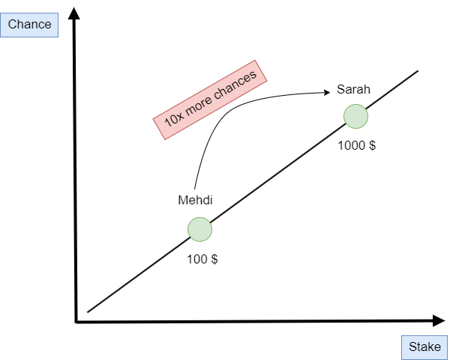
Proof of Stake
=> Liner Correlation
It favors rich people, but it's more fair than proof of work.
In Proof of work rich people can enjoy the power of economies at scale.
1kwh = 1$ | 1000 kwh ≠ 1000$
800$

Slide 10
Forging new Block
The chosen node to valid a block will check all the transactions within it are indeed valid.
If everything checks out, the node signs off on the block and adds it to the blockchain
As a reward, the node receives a block reward + the fees that are associated with each transaction
=> But! How can we trust other validators on the network ?
Notes:
After this you are now one of these nodes

Slide 11
Stake as Financial Motivator
Validators will lose part of their stake if they behave maliciously.
We can trust the validator as long as the stake is higher than what he gets from transactions fees.
=> If a node decides to stop being a validator, his stake plus all the transactions fees that he got will be released after a certain period of time.
Notes:
After this you are now one of these nodes

Slide 12
PoW vs PoS
Everyone can try to mine but only few are able to.
Significant energy
Expensive equipment
Everyone can stake and get randomly selected to forge the new block
Less energy
Less expensive equipment
Notes:
After this you are now one of these nodes

Slide 13
51% attack
=> Depends on the value of the cryptocurrency
Notes:
After this you are now one of these nodes

Slide 14
Random Validator
Each blockchain has his own factors to pick the random validator
=> The following is a list of common factors:
Total coins stacked
How long you have been stacking
Randomness
Notes:
After this you are now one of these nodes

Slide 15
How short is the race ?
In proof of work, the more people are running (mining) the more the race is long => the work is going to be harder and harder=> blocks are not solved too quickly but also not solved too slowly
In Proof of stake, there is no race! => a single computer can do the job => blocks are generated too quickly
Notes:
After this you are now one of these nodes

Slide 16
The transition PoW to PoS
=> it's a good idea to move from PoW to PoS when the network grows very large.
BUT! you should not do it :
Too early: too easy to do a 51% attack.
Too late: lot of miners are wasting massive amount of electricity
Notes:
After this you are now one of these nodes

Slide 17
PoW Economics
PoW:
Investing electricity => this incentives miners to find cheap electricity
Investing computer hardware => Increase of production for equipment manufacturers
Notes:
After this you are now one of these nodes

Slide 18
PoS Economics
PoS:
To become a validator you will be incentivized to buy the coin and stack it.
Instead of investing in hardware and electricity, you are actually investing in the native coin itself
High demand on the coin
=> In theory PoS should increase the price of the coin
Notes:
After this you are now one of these nodes

